Slide 1
Module 23

Slide 2
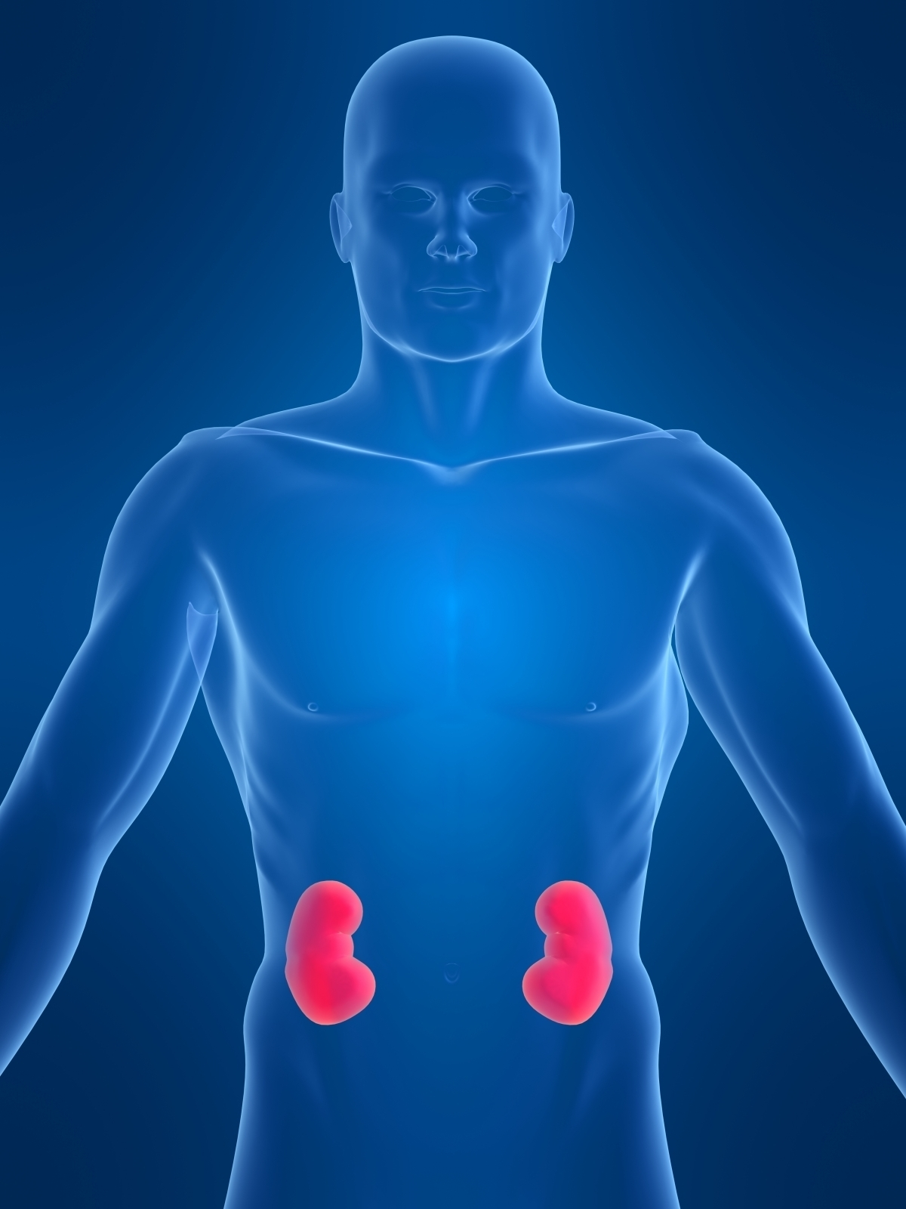

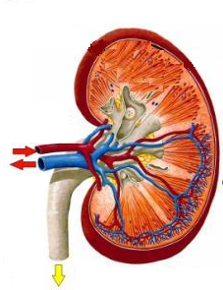
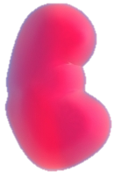
Kidneys are bean shaped organs.
Situated at the back side of the abdomen, one on either side of the vertebral column
Basic filtration unit in the kidney is
NEPHRON
A cluster of thin walled capillaries
Called as
Bean shaped

Slide 3
Structure of NEPHRON
Let us see the process of urine formation
Bowman’s capsule
Blood contains urea, ammonia, uric acid, water and other useful substances.
The cup shaped upper end is called as
The coiled tube like structure is called as
The duct is called as collecting duct.
The renal artery enters the bowman’s capsule and forms a network of capillaries called as
The nephron is surrounded by a network of capillaries
Tubule
Glomerulus
Renal artery
Collecting duct
Capillaries

Slide 4
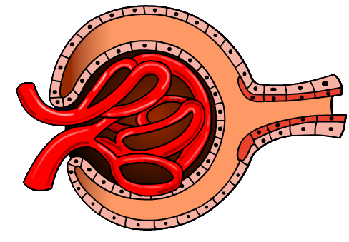
This blood enters the glomerulus through the renal artery.
When blood passes through the glomerulus, it gets filtered.
Urea, uric acid, ammonia, water and other useful substances get filtered out from the blood and this fluid collects in the bowman’s capsule.
This fluid is called as glomerular filtrate.
The filtered blood is sent back to the heart through the renal vain.

Slide 5
The glomerular filtrate passes through the tubule.
The remaining fluid containing the waste forms the urine which passes through the tubule and enters the collecting duct.
In the tubule, reabsorption of water and useful molecules takes place.

Slide 6
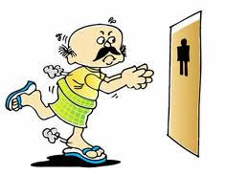
Eventually the urine enters the ureters and is carried to the urinary bladder.
It is stored in the urinary bladder and from there it is thrown out through the urethra.

Slide 7
Thank You

